Slide 1
ITLG311 - Business Communication
Faculty of ICT, Mahidol University
Semester 1, 2026-27
Session 03: Adapting The Message

Slide 2
Previously:
Unit 1: Getting Started: What Is Business Communication?
Fundamentals of Writing for Business Purposes:
Understand the purpose and goals of the course, lesson/unit structures, and evaluation formats
Recognize basics of writing for business purposes, and how it differs from other purposes of communication
Focus On Audience, Tone and Function
Understanding incoming messages and forming responses that match the purpose and focus
Understand Internal vs External messaging
Recognize the importance of accuracy and readability

Slide 3
What Makes a Business Message Effective?
Notes:
Bring back the Week 2 framework:
AUDIENCE
Who am I communicating with?
PURPOSE
Why am I communicating?
INFORMATION
What does the reader need to know?
TONE
How should I communicate it?
ACTION
What should the reader do?
This is a direct continuation of Week 2, where you already taught audience, tone, function and internal/external messaging.

Slide 4
Homework/Feedback:

Slide 5
This Week:
Recognize the purpose, audience and key information in business messages.
Adapt the amount of information, tone and language for different audiences.
Structure a professional business email using appropriate structures and functional language.
Evaluate and improve messages for accuracy and readability.
Apply these principles to communicate the same information to different audiences.

Slide 6
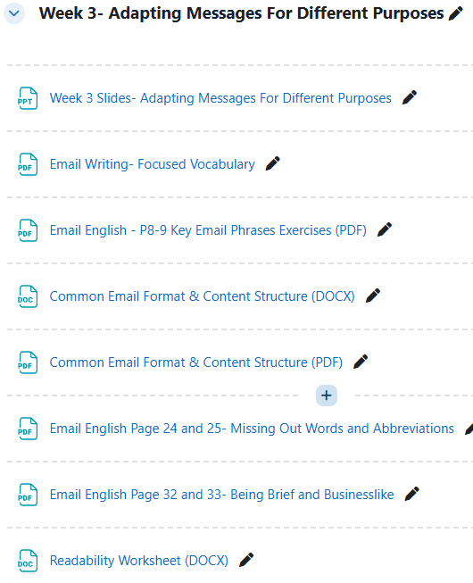
Today’s Reference Materials/Resources

Slide 7
Communicating the ‘Right Information’
Every message plan requires 3 key questions to be answered:
What is the primary function of the message?
What does the reader need to know?
What should the reader do after the message?
These questions can be answered by considering the following:
WHAT?
WHO?
WHEN?
WHERE?
ACTION?
What is the situation - What happened / What is being requested or provided?
Who was / is / will be involved?
What date, time or deadline?
Where does the situation (or follow-up) occur?
What does the reader need to do next?
Notes:
OK information, but poorly formatted
Partially fixed

Slide 8
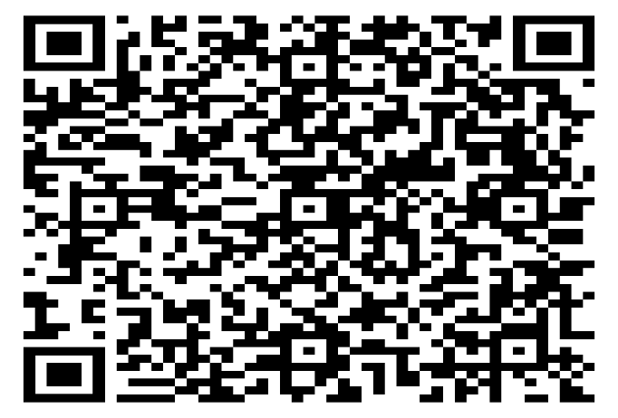
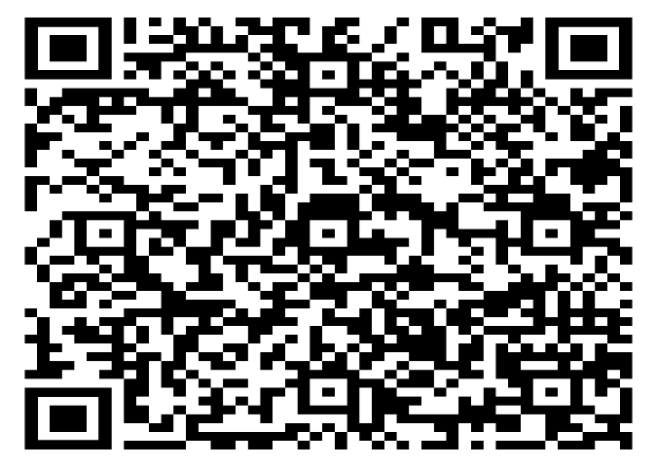

Purposeful Messaging
List as many Message Functions as you can:
Reference guide:
Try It:
Notes:
Message Functions include:
Making a request – asking for information or an action
Responding to a request – providing information or acknowledging action
Making a complaint – identifying and expressing a problem
Responding to a complaint – apologizing and attempting to provide a solution
Beyond that, also different tones:
Delivering good news
Delivering bad news
Etc…
Email Section 2 – Key Phrases Worksheet
Write a subject Line
Complete Task B – phrases that indicate message focus/purpose

Slide 9

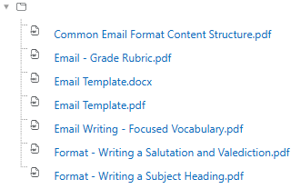
A Structured Message: Emails
Emails are one of the most common types of messages in business situations
To be as effective as possible, they follow a specific structure, and it is important to get it right
Notes:
Review the Common Structure of an Email
Note: Students should already know the majority of this information, but it is important that they recognize the terms we are going to use:
Header Details
Salutation (targeting the receiver)
Opening: purpose of the message – no flowery waffle such as ‘I hope this email finds you well”
Focus: the main part of the message – the specific detail that is to be communicated
Closing: Wrap up and clarify next step
Valediction
Work through template and reference guides:
Example:
Ideally try to demonstrate an example email good/bad
I suggest a chat-GPT sample email, which you break down, evaluate, and explain how to improve
Application: If (time allows)
Ask students to draft their own example email (AI brainstorming permitted)
Share with partners/peers
Refer to the email grade rubric to help determine overall qualities

Slide 10

Emails: Not as simple as you think
Used in business to communicate with Colleagues, Stakeholders, Clients, & Customers
Used for Formal communication, marketing, newsletters, documentation
Follows a clearly identifiable format:
  Subject Line, Message Body (Opening, Main Message, Action, Closing)
Effective for providing detailed information and highly versatile for different situations. Easily scalable for mass marketing
Can be easily overlooked (inbox clutter)
Potential for being marked as spam
Requires careful crafting to avoid miscommunication

Slide 11
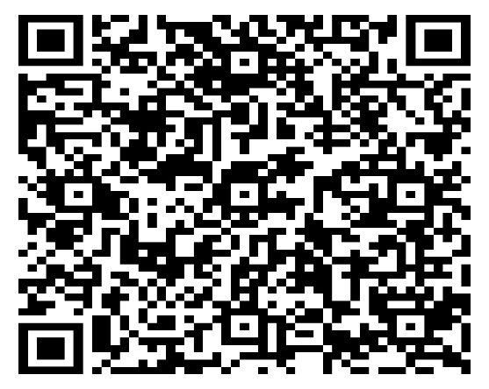

Email Structure:
Define the following:
Subject Line:
Opening
Main Message:
Action:
Closing:

Slide 12
Short and Long Messages
Not only the message/idea is important, but also the manner in communicating it.
Consider Message Length, Amount of Detail, and Level of Language:
Shorter messages often:
focus on one immediate purpose
contain less (or no) background information
use concise language
may be less formal when the relationship allows it
Longer messages often:
require more structure
include background or detailed explanation
contain multiple pieces of information
may require a more formal tone depending on the audience
Length depends on the purpose and the reader — not simply on formality.

Slide 13
Short Messages
When creating short email messages, consider:
1. Clarity and Precision:
2. Brevity:
3. Tone:
4. Audience Awareness:
5. Immediate Purpose:
Notes:
1. Clarity and Precision:
Ensure the message is clear and to the point, avoiding unnecessary details. Every word counts.
2. Brevity:
Keep the message concise, using as few words as possible to convey the main idea.
3. Tone
Maintain an appropriate tone, as short messages can easily come across as abrupt or rude. Use of emojis or punctuation can help convey emotion when necessary.
4. Audience Awareness:
Tailor the message to the recipient's expectations and the platform's norms, considering the informality or formality required.
5. Immediate Purpose:
Focus on the immediate action or response needed. Short messages often serve to prompt quick decisions or convey urgent information.

Slide 14
Longer Messages
When creating longer email messages, consider:
1. Structure and Organization:
2. Detail and Explanation:
3. Tone and Professionalism:
4. Purpose and Relevance:
5. Call to Action or Conclusion:
Notes:
1. Structure and Organization:
Organize the content with clear sections, headings, or paragraphs to guide the reader through the message.
2. Detail and Explanation:
Provide enough detail to fully explain the topic, including background information or supporting arguments where necessary.
3. Tone and Professionalism:
Adopt a tone that reflects the formality of the situation. In longer messages, you have more space to nuance your tone and ensure it matches the purpose.
4. Purpose and Relevance:
Ensure that every section or paragraph serves the overall purpose of the message and remains relevant to the main topic.
5. Call to Action or Conclusion:
Conclude with a clear call to action or summary, providing the reader with a next step or takeaway from the message.

Slide 15
Adapting the message for Various Needs
Short vs. Long Messages
The length and style of a message should depend on the purpose, platform, and audience.
When changing from a long, formal message to a short, informal one, you should:
Maintain the main ideas – keep the important information
Maintain the purpose – make sure the message still achieves its goal
Consider the audience – adapt the language and level of detail to the reader’s level
To make a message shorter while keeping it clear and connected:
Use shorter forms and simpler language.
Remove unnecessary or repeated words.
Focus on the most important information.
Use short sentences where appropriate.
Remove information that the audience can easily understand from the context.

Slide 16
Short-form Language
Due to short message limitations, be direct. Make every word matter
Use short-form language such as acronyms to convey well known ideas in a short manner
Try it: Define the full-length version of these short form expressions:
Task: Write sentences that incorporate these short form phrases
ASAP
BTW
FYI
OTOH
TIA
FWIW
NP
IMHO
AFAIK
LOL
TLDR
TBD/TBA
Notes:
ASAP (As Soon As Possible)
Definition: A request or indication that something should be done immediately or with urgency.
Usage Example: "Please send the report ASAP so we can review it before the meeting."
BTW (By The Way)
Definition: A phrase used to introduce an additional comment or piece of information that is related but not the main point of the conversation.
Usage Example: "BTW, did you hear about the new policy change?"
FYI (For Your Information)
Definition: Used to indicate that the information being shared is for the recipient’s knowledge, without necessarily requiring action.
Usage Example: "FYI, the client meeting has been rescheduled to 3 PM."
OTOH (On The Other Hand)
Definition: Used to present an alternative viewpoint or counterargument.
Usage Example: "I like the idea of expanding, but OTOH, it might be too costly right now."
TIA (Thanks In Advance)
Definition: A polite way to express gratitude before a favor or action has been completed.
Usage Example: "Could you review this document by tomorrow? TIA!“
FWIW (For What It’s Worth)
Definition: when you are giving someone a piece of information and you are not certain if that information is useful or important
Usage: For what it's worth, I think he may be right.
NP (No Problem)
Definition: A casual way of saying that a request is easy or that you’re happy to help.
Usage Example: "Thanks for the help today!" - "NP, happy to assist."
IMHO (In My Humble Opinion)
Definition: A phrase used to express that the following statement is the speaker's personal opinion, often implying modesty or a desire not to be overly assertive.
Usage Example: "IMHO, we should prioritize customer feedback in the next update."
AFAIK (As Far As I Know)
Definition: A phrase used to indicate that the information being provided is to the best of the speaker's knowledge, but they acknowledge that it might not be complete or fully accurate.
Usage Example: "AFAIK, the project deadline is still next Friday."
LOL (Laughing Out Loud)
Definition: A way to express amusement or indicate that something is funny.
Usage Example: "That joke was hilarious, LOL!"
These abbreviations are commonly used in digital communication to save time and convey tone quickly.
TLDR (Too Long, Didn’t Read)
Usage example: “The report you sent was TLDR. Can you please summarize it for me?”
Obviously very informal and borderline jokey - should only be used in a setting where there is an extremely good relationship between parties, as if used in the wrong way will appear dismissive and disrespectful
TBD/TBA
Variations: To be Determined/To Be Decided
Variations: To Be Agreed/To Be Announced
Context of usage usually helps determine exact meaning
NOTE: LOL is an example of common INFORMAL language and would not really be used in Business Purposes…. But is just a point of reference of how these terms can be used

Slide 17
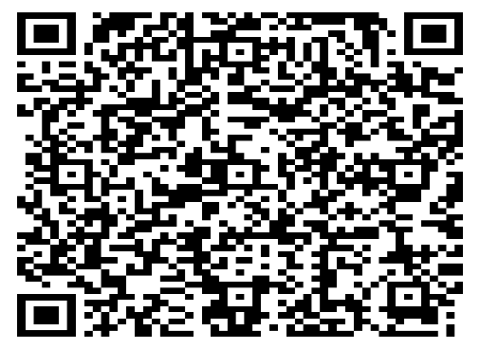
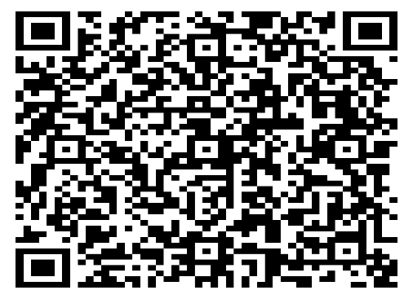
Short-form Language Exercises

Slide 18
Readability
What is Readability?
Definition:
The ease with which a reader can understand and engage with written content, especially in emails and short messages for business purposes
High readability is achieved through clear, concise language, proper formatting, and logical organization, making the message straightforward and accessible to the reader
To improve readability, consider:
Clarity: Using simple and direct language to convey the message
Language: Matching the vocab to the audience, ensuring it is understandable and relatable
Conciseness: Keeping the message brief and to the point
Formatting: Using bullet points, headings, and short paragraphs to enhance visual appeal and understanding

Slide 19
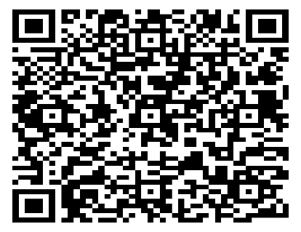

Assessing Readability
Dear All,
We hope this message finds you well. It is important to bring to your attention that, due to the scheduled training session for the school counselors which will be taking place in LAB105, there will be a change in the parking arrangements that might affect your usual parking routines. Specifically, all parking lots situated in the vicinity of the ICT Building will be exclusively reserved for the use of the school counselors who will be attending the aforementioned training session. This event is set to occur on Friday, the 28th of August, in the year 2026. We understand that this might cause some inconvenience to you. Therefore, we suggest that you consider alternative parking arrangements in advance to avoid any disruption to your schedule. You might want to explore other parking options around the campus, such as those near the Administration Building or the Library. Additionally, carpooling with colleagues or using public transportation might be viable alternatives. Planning your arrival time to allow for potential delays in finding a parking space would also be advisable. We apologize for any inconvenience this may cause you and appreciate your understanding and cooperation in this matter.
Best Regards
Q: How can the readability of this message be improved?
TASK: Rewrite the message in the worksheet to make it more readable

Slide 20
Improving Readability
List possible improvements:
Possible rewrite:
Dear All,
Please be informed that all parking lots near the ICT Building will be reserved exclusively for the school counselors participating in the training at LAB105 on Friday, 28 August 2026.
We apologize for any inconvenience this may cause you.
Best Regards,
Notes:
Reasons for Bad Readability
Wordiness: The message is overly long and includes unnecessary details.
Complex Sentences: Use of lengthy, complex sentences that are harder to follow.
Redundancy: Repeating information and providing excessive suggestions.
Lack of Focus: Including too much background information and multiple suggestions disrupts the main message.
Formality: Excessive formality can make the message feel stiff and less engaging.

Slide 21
Can’t I just use AI?
Business experts say:
While AI can be a powerful tool in business communication, it's not a complete replacement for human interaction and should be used thoughtfully and ethically.
AI can assist with tasks like creating message template, drafting content, analyzing communication patterns, and improving efficiency, but it cannot replicate human connection, emotional intelligence, and nuanced understanding that are crucial for effective communication.

Slide 22
Can’t I just use AI?
AI can give you ideas or support your linguistic deficiencies
But AI cannot do all the work for you
AI only provides output that is as effective as the input it is based on
AI language models are not experts at critical thinking, and tend to over-generalize
AI language models can provide grammatically correct sentences that are meaningless or unrelated to the task
Even if you use AI, you must have the knowledge and skills to evaluate the quality of its output, therefore, YOU MUST LEARN the basic principles of business communication

Slide 23
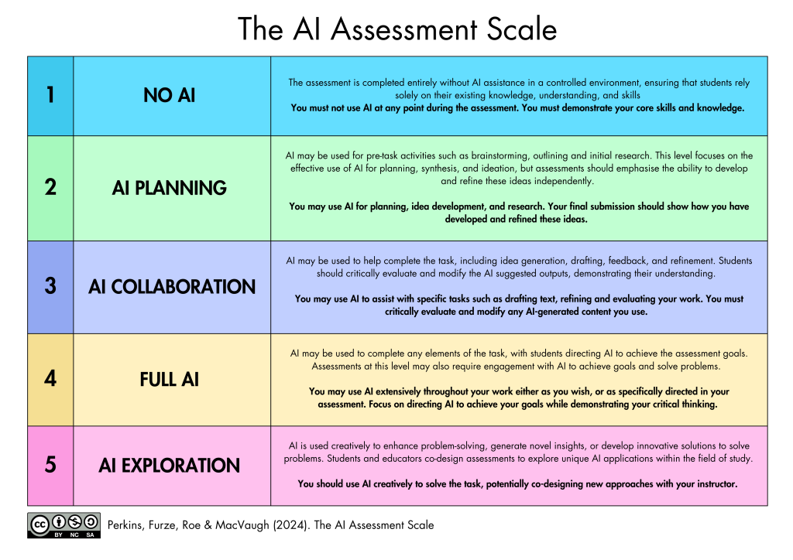
Can’t I just use AI?
In this course:
SOME Classwork exercises will allow Category 2: AI Planning.
Your instructor will inform you when it will be allowed in class-based activities.
Your formally graded assessments will be Category 1: NO AI allowed
The assessment is completed entirely without AI assistance in a controlled environment, ensuring that students rely solely on their existing knowledge, understanding, and skills
You must not use AI at any point during the assessment. You must demonstrate your core skills and knowledge

Slide 24
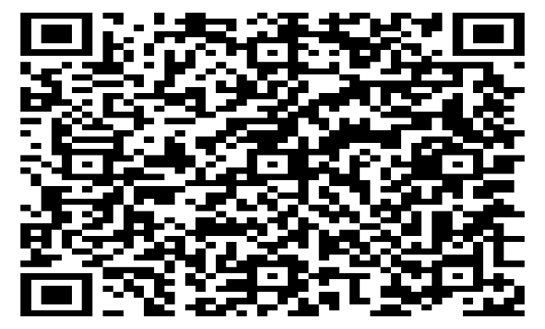
Activity Expansion: Put it together
Task:
Rewrite the email you wrote before as a short chat message to a colleague.
Audience: Colleague
Tone: Less formal / professional
Format: short email
Length: 40–50 words
Keep the essential information
Remove unnecessary details
Use shorter expressions
Stay clear and professional
Reflection:
Does the language of the messages match the purpose?
How could you improve it further?

Slide 25
Key Takeaways
Effective business communication means giving the right information to the right audience in the right way.
If the message is unclear, unstructured, or low-readability, it will not be effective.
Next week, we will explore how these principles change when we communicate through different digital platforms.

Slide 26
Finally….
Congratulations on completing another class
Homework:
Activity Expansion Email Rewrite
Post into Mycourses
Have a great week everyone!
See you next week
Until then, Take Care & Stay Safe

